Slide 1
Algorithm Analysis
Chaklam Silpasuwanchai

Slide 2
Readings
Chapter 3, Growth of Functions, Cormen et al. (2009). Introduction to Algorithms, Third Edition (3rd ed.). The MIT Press.
Chapter 2, Algorithm Analysis, Skiena, S. S. (2008). The Algorithm Design Manual, Second Edition (2nd ed.). Springer Science & Business Media.
Chapter 3 - Algorithm Analysis, Goodrich, M., Tamassia, R., Goldwasser M. (2013). Data Structures and Algorithms in Python. 1 ed. Wiley

Slide 3
Outline
RAM Model of Computation
The Big Oh Notation
Logarithms

Slide 4
The RAM Model of Computation

Slide 5
The RAM Model of Computation
Machine-independent algorithm depend on a hypothetical computer called the Random Access Machine or RAM. This RAM computer has the following characteristics:
Each simple operation (+, *, -, =, if, call) takes exactly one time step
Loops and subroutines are not considered simple operations. Instead, they are the composition of many single-step operations
Each memory access takes exactly one time step
This computer has no knowledge of cache, storage, or any software engineering concepts like object-oriented programming

Slide 6
The RAM Model of Computation
Under the RAM model, we measure run time by simply counting the number of steps on a given problem
RAM model can be oversimplified:
Multiplying takes more time than addition
RAM ignores threading
Memory access depends whether data sits on cache or disk
Yet, RAM model is excellent because it is simple, capturing only essential behavior of computers and thus gives a good estimation.

Slide 7
Big Oh Notation

Slide 8
Simplified estimation of complexity
Complexity is defined by a numerical function, which can be complicated:
Algo #1: 12754n² + 100000n + 834 lg₂n + 13546
Algo #2: 754n³
Introduce simplified notation called Big Oh notation
Only the leading term has the biggest effect as n increases
Since n³ > n², thus algo 1 is faster
The BigO ignores multiplicative constants, for example, 2n and n are identical because these constants have less impact as n increases

Slide 9
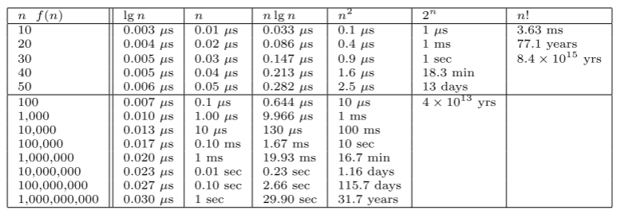
Why Big Oh makes sense
All algorithms take roughly same time for n = 10
Any algorithm with n! running time becomes useless for n ≥ 20
Algorithms whose running time is 2^{n} is ok, but become impractical for n > 40
Quadratic algorithms (n²) remain usable until n = 10,000. Hopeless for n > 1,000,000
Linear algorithms (n) and n log n algorithms remain practical even for one billion items
Key point is that n has the largest impact, not constants or lower order items. Thus Big Oh simplification makes sense
Notes:
For moderate values of n, the quadratic algorithm could very well take less time than the linear one, for example if c is significantly smaller than d and/or k is significantly smaller than q. However, the linear algorithm will always be better for sufficiently large inputs. Remember to THINK BIG when working with asymptotic rates of growth.

Slide 10
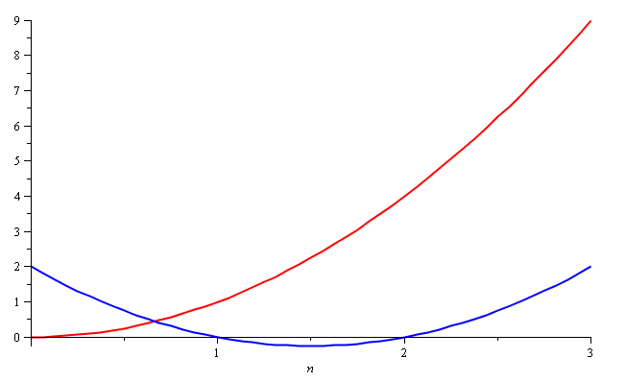
Why Big Oh makes sense
Consider the two functions
f(n) = n² and g(n) = n² – 3n + 2
Around n = 0, they look very different

Slide 11
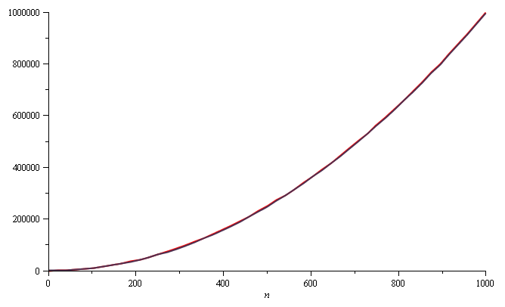
Why Big Oh makes sense
Yet on the range n = [0, 1000], they are (relatively) indistinguishable:

Slide 12
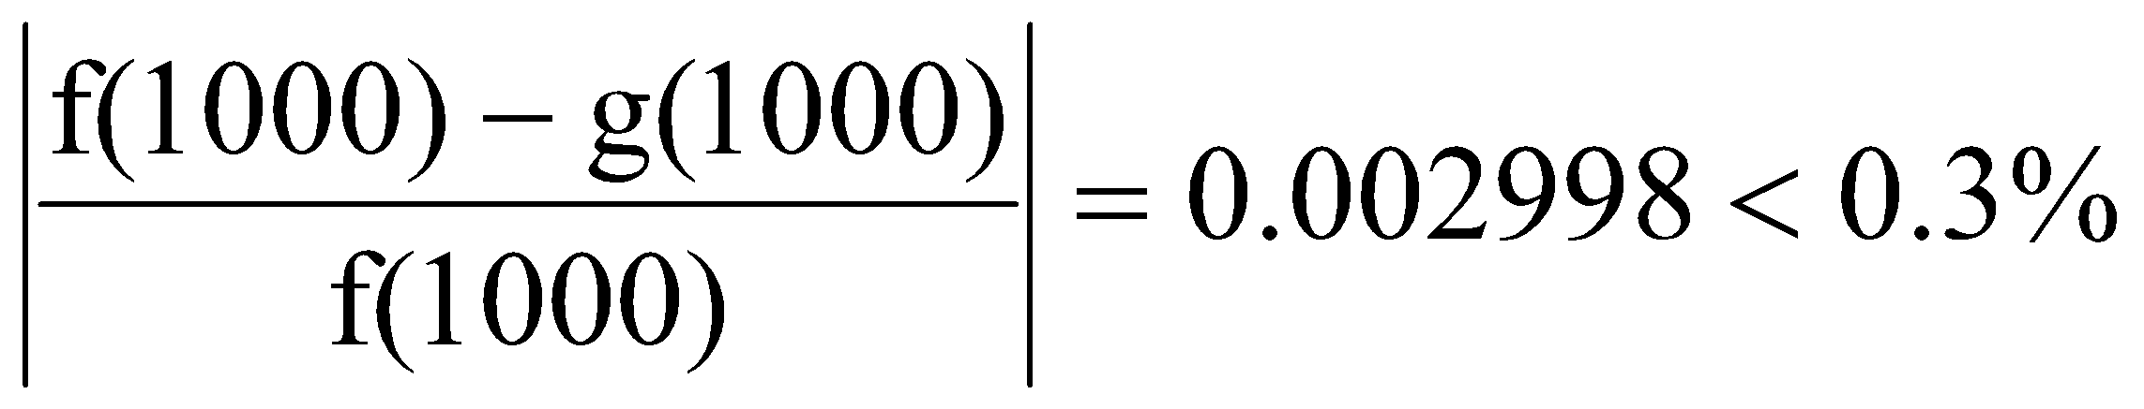
Why Big Oh makes sense
The absolute difference is large, for example,
f(1000) = 1 000 000
g(1000) = 997 002
but the relative difference is very small
and this difference goes to zero as n → ∞

Slide 13
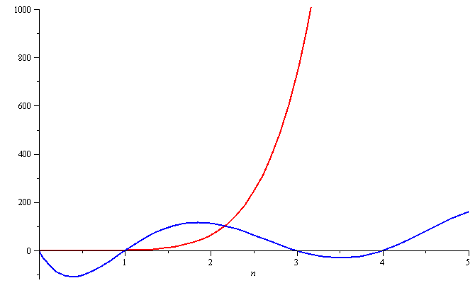
Why Big Oh makes sense
To demonstrate with another example,
f(n) = n⁶ and g(n) = n⁶ – 23n⁵+193n⁴ –729n³+1206n² – 648n
Around n = 0, they are very different

Slide 14
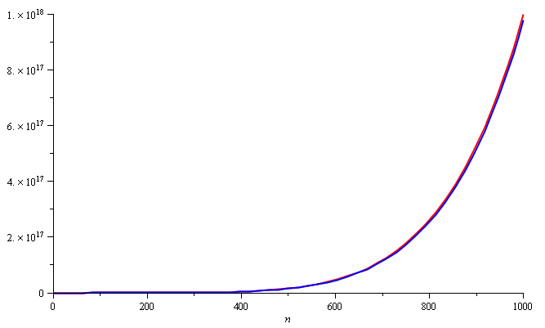
Why Big Oh makes sense
Still, around n = 1000, the relative difference is less than 3%

Slide 15
Why Big Oh makes sense
The justification for both demonstrations being similar is that, in both cases, they each had the same leading term:
n² in the first case, n⁶ in the second
Constants have less effect as n approaches infinity
Thus, it makes sense to simplify the complexity functions, by ignoring constants and lower-order items

Slide 16
The Big Oh Notation
f(n) is O(g(n)) if there exist positive constants c and n₀ such that f(n) ≤ c * g(n) for all n ≥ n₀
running time, for every input n, is at most a constant times g(n), for sufficiently large n
f(n) is Ω(g(n)) if there exist positive constants c and n₀ such that 0 ≤ c * g(n) ≤ f(n) for all n ≥ n₀
running time, for every input n, is at least a constant times g(n), for sufficiently large n
f(n) is 𝚯(g(n)) if there exist positive constants c₁, c₂, and n₀ such that c₁ * g(n) ≤ f(n) ≤ c₂ * g(n) for all n ≥ n₀
running time, for some input n, is exactly a constant times g(n), for sufficiently large n
Notes:
For moderate values of n, the quadratic algorithm could very well take less time than the linear one, for example if c is significantly smaller than d and/or k is significantly smaller than q. However, the linear algorithm will always be better for sufficiently large inputs. Remember to THINK BIG when working with asymptotic rates of growth.

Slide 17
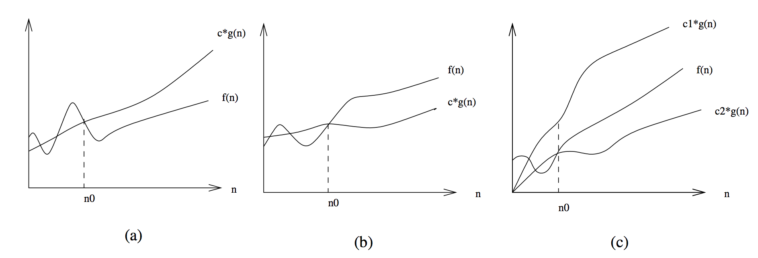
O (Oh) , Ω (Omega), and 𝚯 (Theta)
The definitions imply a constant n₀ beyond which they are satisfied. We are not concerned about small values of n.
Notes:
For moderate values of n, the quadratic algorithm could very well take less time than the linear one, for example if c is significantly smaller than d and/or k is significantly smaller than q. However, the linear algorithm will always be better for sufficiently large inputs. Remember to THINK BIG when working with asymptotic rates of growth.

Slide 18
Big Oh (Upper Bound) Examples
3n² − 100n + 6 = O(n²) because I choose c = 3 and 3n² > 3n² − 100n + 6
3n² − 100n + 6 = O(n³) because I choose c = 1 and n³ > 3n² − 100n + 6 when n > 3
3n² − 100n + 6 ≠ O(n) because for any c, c · n < 3n² when n > c
Notes:
For moderate values of n, the quadratic algorithm could very well take less time than the linear one, for example if c is significantly smaller than d and/or k is significantly smaller than q. However, the linear algorithm will always be better for sufficiently large inputs. Remember to THINK BIG when working with asymptotic rates of growth.

Slide 19
Big Omega (Lower Bound) Examples
3n² − 100n + 6 = Ω(n²) because I choose c = 2 and 2n² < 3n² − 100n + 6 when n > 100
3n² − 100n + 6 ≠ Ω(n³) because I choose c =1 and 3n² − 100n + 6 < n³ when n > 3
3n² − 100n + 6 = Ω(n) because for any c I choose, cn < 3n² − 100n + 6 when n > 100c
Notes:
For moderate values of n, the quadratic algorithm could very well take less time than the linear one, for example if c is significantly smaller than d and/or k is significantly smaller than q. However, the linear algorithm will always be better for sufficiently large inputs. Remember to THINK BIG when working with asymptotic rates of growth.

Slide 20
Big Theta (Average Bound) Examples
3n² − 100n + 6 = Θ(n²) because O and Ω
3n² − 100n + 6 ≠ Θ(n³) because O only
3n² − 100n + 6 ≠ Θ(n) because Ω only
Notes:
For moderate values of n, the quadratic algorithm could very well take less time than the linear one, for example if c is significantly smaller than d and/or k is significantly smaller than q. However, the linear algorithm will always be better for sufficiently large inputs. Remember to THINK BIG when working with asymptotic rates of growth.

Slide 21
Common orders of growth
1 | No dependence on n
log n | logarithmic
n | linear
n log n | super linear
n² | quadratic
n³ | cubic
2^{n} | exponential
3^{n} | exponential
2! | factorial
Increasing complexity

Slide 22
Exercises
Is f(n) = O(g(n))? T/F
f(n) = n+2; g(n) = 2n+1
f(n) = n+2; g(n) = n²+1
f(n) = √n ; g(n) = log n
f(n) = log n¹⁰; g(n) = 100 + log n
f(n) = 10; g(n) = log10
f(n) = 2^{n}; g(n) = 10n²
f(n) = 9√n + n, g(n) = n²
f(n) = 2^{n}+1, g(n) = 2^{n}
f(n) = 2^{2n}, g(n) = 2^{n}
Notes:
Is 2^{n}+1 = O(2^{n})?
True. 2^{n+1} = 2 * 2^{n} , thus I choose c = 3, then 2^{n+1} ≤ 3 * 2^{n} once n exceeds certain values
Is 2^{2n} = O(2^{n} )?
False. 2^{2n} = 4^{n}, 4^{n} ≤ c * 2^{n} cannot be true, once n exceeds certain values

Slide 23
Logarithms

Slide 24
Logarithm
A logarithm is simply an inverse exponential function. Saying b^{x} = y is same as x = log_{b}y.
As you know, exponential function grows fast. Thus logarithms grows slowly
Logarithms, as in algorithms, often arise as complexity where things are repeatedly halved or repeatedly divide and conquer

Slide 25
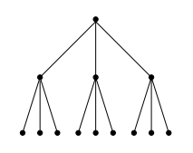
Logarithm
Binary search is a good example of O(log n)
To locate a person p in a telephone book containing n names, you start by comparing p against the middle, say Monroe, Marilyn. Then depending on what is p, you completely discard one half. You continue the same fashion comparing p with the new middle, say George, Graham
The step is equal to how many times the names can be halved until only one name is left. By definition this is exactly log₂n
This log is very powerful because one can find any name using only 20 comparisons in a million-name phone book!

Slide 26
Logarithm and Trees
A binary tree of height 1 can have up to 2 leaf nodes, while a tree of height two can have up to four leaves. What is the height h of a rooted binary tree with n leaf nodes? Note that the number of leaves doubles every time we increase the height by one. To account for n leaves, n = 2^{h} which implies that h = log₂n
For a tree that have d children, one can easily generalize that h = log_{d}n because number of possible leaves multiplies by d every time we increase the height by one (n = d^{h})
The key message here is that because very short trees can contain many leaves, trees prove fundamental to fast data structures

Slide 27
Logarithm and Big Oh
The base of the algorithm has no real impact on the complexity. For example, log₂(1,000,000) = 19.9316, log₃(1,000,000) = 12.5754, log₁₀₀(1,000,000) = 3.
A big change in the base only produces small differences. Also, converting base only requires dividing with a constant log_{c}a. Thus we usually justified to ignore the base of the log in Big Oh, and simply writes log n ignoring the base

Slide 28

Logarithm and Big Oh
Doing a binary search on a sorted array of n² things requires only twice as many comparisons as a binary search on n things.

Slide 29
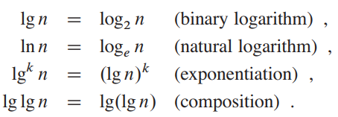
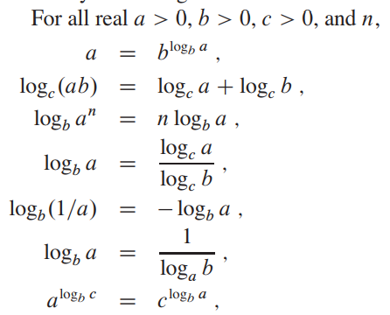
Properties of Logarithm

Slide 30
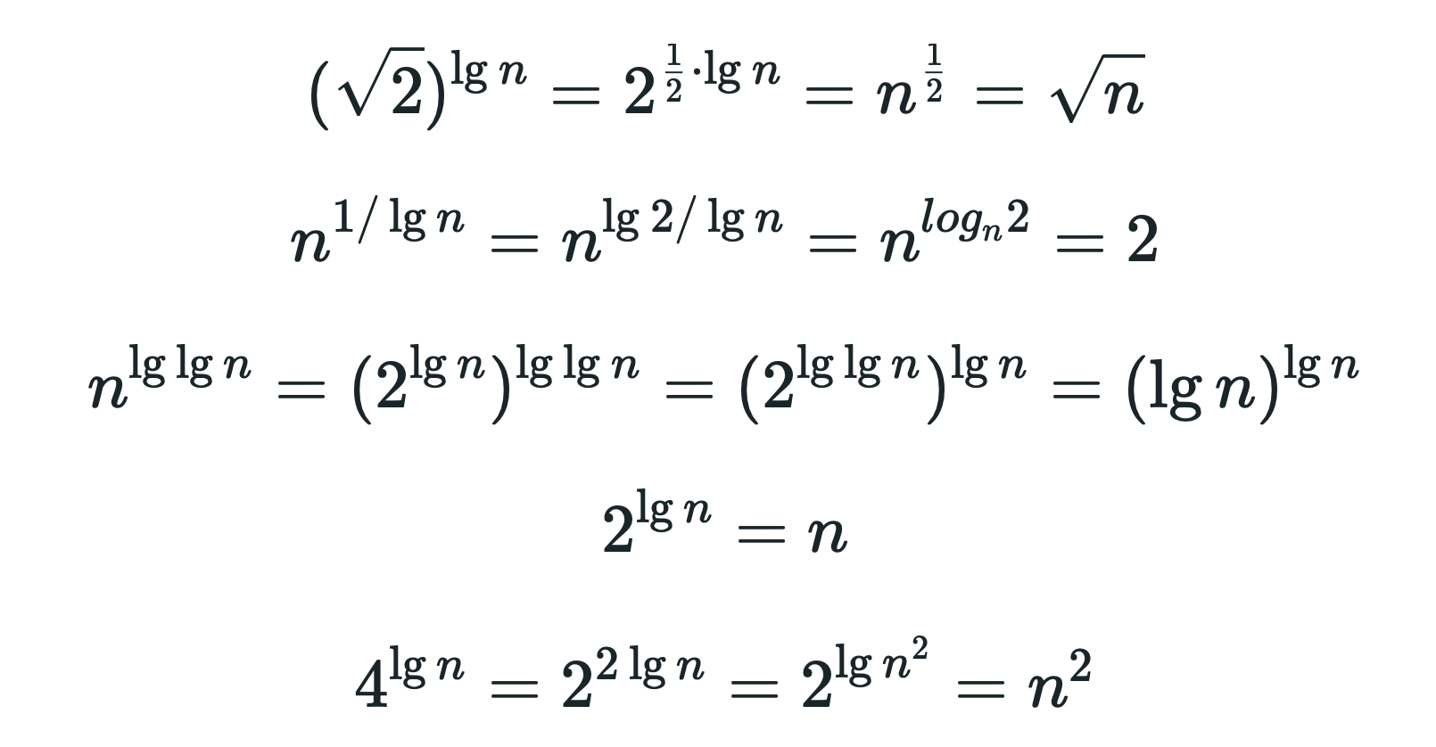
Exercises
Prove the followings:
Notes:
Use rule 7
Use rule 4 then 7
Use rule 7, then lg2 = 1
Use rule 7, then lg2 = 1
Use rule 3

Slide 31
Assignment
Graph different order of growth functions
Submit in google classroom before next week
Copying from internet or friends will receive 0 marks

